Slide 1
A NonPaninian Approach to Sanskrit Morphophonology
Ivan Tolchelnikov
MSU, SZS, SRI
19th WSC, 2025

Slide 2
Table of Contents
1. Introducing Ourselves
2. Issues in the Traditional European Approaches
3. Phonological Processes: Classification 4. Core Concepts: Morphological Position and Alternation Type 5. Goals and Achievements

Slide 3
Tasks and Issues
1. Didactical: how to teach adult person precise Sanskrit grammar?
2. Scientifical: how to verify corpus tagging?
3. Practical: how to spellcheck scanned documents?
⇒ Same issues in western grammars:
1. Ambiguous nomenclature;
2. Vague rules.

Slide 4
Nomenclature Issue
Case 1:
uc – uc/oc – ?auc ‘to be pleased’ → √uc;
uc – vac – vāc ‘to speak’ → √vac.
Case 2:
us – vas – vās ‘to shine’ → ?√us, but not distinguished from √uc-type;
vas – vas – vās ‘to clothe’ → √vas, but not distinguished from √vac-type.
Minimal task: define for all morphemes their classificatory parameters regulating alternation, seṭ/aniṭ, reduplication (for verbal roots), etc.
Maximal task: develop nomenclature system that includes all that parameters into morpheme name.

Slide 5
Rule Issue (1)
Whitney W.D., Sanskrit Grammar (1896)
932. The tense-sign of this future <…>The root has the guṇa-strengthening. In the pair of morphemes “A+B”:
if A = verbal root;
if B = -sya-;
A turns guṇa grade.
A |  | B
√ji “to win” | + | -sya- | = | jesya- | guṇa
√kṛ “to make” | + | -sya- | = | karsya- / kariṣya- | guṇa
√bhū “to be” | + | -sya- | = | bhaviṣya- | guṇa
√uøc “to speak” | + | -sya- | = | vakṣya- | guṇa

Slide 6
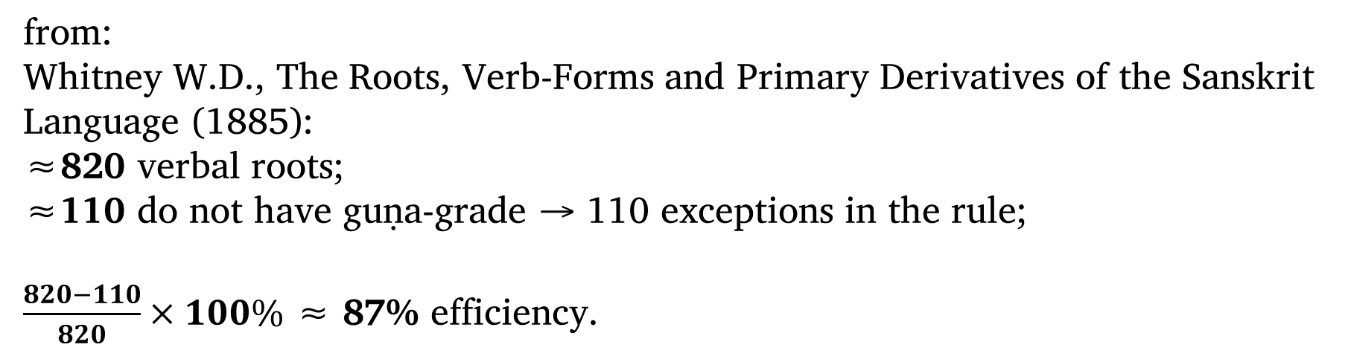
Rule Issue (2)
A |  | B
√dhau “to run” | + | -sya- | = | dhāviṣya- | vṛddhi
√tai “to stretch” | + | -sya- | = | tāyiṣya- | vṛddhi
√hiṃs “to injure” | + | -sya- | = | hiṃsiṣya- | zero
√jṛmbh “to gape” | + | -sya- | = | jṛmbhiṣya- | zero
from:
Whitney W.D., The Roots, Verb-Forms and Primary Derivatives of the Sanskrit Language (1885):
≈820 verbal roots; ≈110 do not have guṇa-grade → 110 exceptions in the rule;
$\frac{820−110}{820}×100\%$ ≈ 87% efficiency.

Slide 7
Rule Issue (3)
Collections of empyrical data:
Whitney W.D., The roots, verb-forms, and primary derivatives of the Sanskrit language (1885);
Digital Corpus of Sanskrit by O. Hellwig (2010-2021);
etc.
Minimal task: develop a grammar with minimal number of exceptions and their comprehensive lists as generalization of that data for Classical Sanskrit using morpheme classificatory parameters.
Maximal task: also generalizing ārṣa/archaic forms (Vedic Sanskrit etc.).

Slide 8
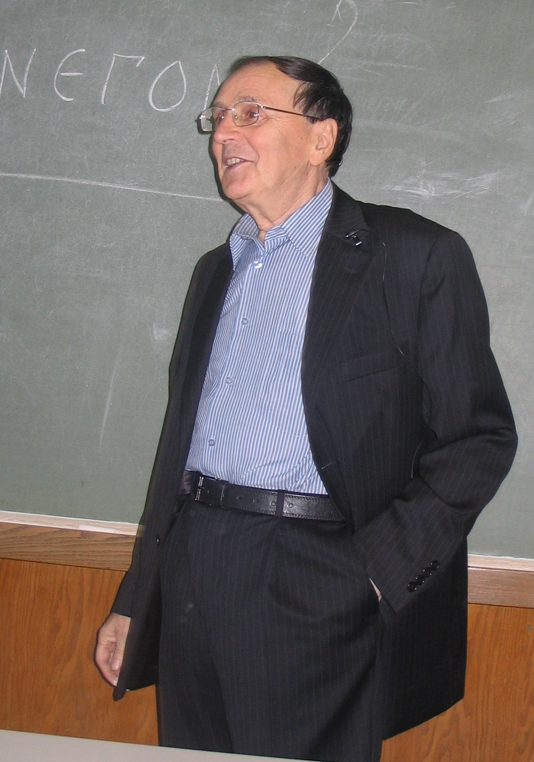
Andrei Zalizniak: Structuralism in Sanskritology
«Morphophonological Classification of the Ancient Indian Language Verbal Roots» (1975):
Critical analysis of Whitney’s and Vaiyākaraṇas’ principles for verbal root nomemclature and rule formulation;
Original morpheme classification regarding alternation parameters;
Sketch of seṭ-veṭ-aniṭ parameters.

Slide 9
Morphophonological Processes
How to transform a chain of morphemes A+B+…+N into actual word AB…N?
E.g., √yuj + -ay- + -s- + -ta- + -m → yuyojayiṣitam;
caus. desid. ppp. n. N. sg. →“desired to make connected/used”.
Processes that can occur during this transformation:
Alternation (Which phoneme is alternated in morpheme? How many grades does it have? Which grade is expected in a morpheme preceding this morpheme?);
Appearance of the connective vowel i/ī;
Reduplication (for verbal roots);
Shift of the alternating element; e.g., atypical guṇa in stheya-, while sthi – sthā – sthā expected, but not *sthi – sthe – sthai;
+ purely phonological changes – sandhi.

Slide 10
Alternation Series: Verbal Roots
Series | Zero Grade | Guṇa Grade | Vṛddhi Grade
A1 | øs | as | ās
A2 | sthø̄ | sthā | sthā
I1 | ji | je | jai
I2 | nī | ne | nai
U1 | stu | sto | stau
U2 | bhū | bho | bhau
R1 | kṛ | kar | kār
R2 | pṝ | par | pār
L | kḷp | kalp | kālp
M1 | gm̥ | gam | gām
M2 | śm̥̄ | śam | śām
N1 | mn̥ | man | mān
N2 | jn̥̄ | jan | jān

Slide 11
Alternation Series: Affixes
Series | Zero Grade | Guṇa Grade | Vṛddhi Grade
A1 | yuñøjanti | yunakti | –
A2 | jānø̄anti | jānāti | –
I1 | buddhiḥ | buddheḥ | vairāgyam
I2 | bhagavatī | – | –
U1 | kṛṇvanti | kṛṇoti | aupaniṣadaḥ
U2 | tanūḥ | – | –
R1 | kartṛbhis | kartari | kartāram
R2 | – | – | –
L | – | – | –
M1 | – | – | –
M2 | – | – | –
N1 | rājn̥ā | he rājan | rājānam
N2 | – | – | –

Slide 12
Alternation: Morphological Position (1)
Cf.:
√i + -ti → eti;
√i + -anti → yanti;
√kṛ+-nu-+-ti → kṛṇoti;
√kṛ+-nu-+-te → kṛṇvanti;
⇒ -ti makes preceding morpheme guṇa, -anti – zero.
Morphological position – the expectation of some grade in every preceding morpheme with the certain following morpheme.
The expectation may not be met:
√as (øs) + -anti → øsanti;
√ad + -anti → adanti, not *ødanti as expected.

Slide 13
Alternation: Morphological Position (2)
1 – expectation of zero grade:
ppp. -(1)ta-; e.g., kṛta-, ita-, but carita-, sevita-, dhāvita-;
3.pl.P. -(1)anti-; e.g., øsanti, yanti, but adanti, bhānti;
etc.
2 – expectation of guṇa grade:
future -(2)sya-; e.g., kariṣya-, bhaviṣya-, but jṛmbhiṣya-, dhāviṣya-;
3.sg.P. -(2)ti; e.g., asti, atti, eti, but īṭṭi,
except U1 series: cf. stauti, so it is actually -(2/3)ti;
etc.
3 – expectation of vṛddhi grade:
aorist 4 ⇔ -(3)s-; e.g., akārṣ-, anaiṣ-,
with many exceptions, so it is actually -(1/2/3)s-;
etc.

Slide 14
Alternation Types
Alternation type – alternation pattern of a morpheme in three morphological positions.
MP Type | 1 ppp. -(1)ta- | 2 future -(2)sya- | 3 aorist 5 ⇔ -(/3)is-
I | zero | guṇa | vṛddhi
√vṛ(I) | vṛta- | variṣya- | vāriṣ-
II | guṇa | guṇa | vṛddhi
√car(II) | carita- | cariṣya- | cāriṣ-
III | zero | zero | vṛddhi
√īḍ(III) | īṭṭa- | īḍiṣya- | aiḍiṣ-
IV | vṛddhi | vṛddhi | vṛddhi
√cai(IV) | cāyita- | cāyiṣya- | cāyiṣ-

Slide 15
Nomenclature Issue Solution
Case 1:
uc – uc/oc – ?auc ‘to be pleased’ → √uc(I)//√uc(III) – variants;
uc – vac – vāc ‘to speak’ → √uøc(I) – guṇa: uac → vac (general sandhi).
Case 2:
us – vas – vās ‘to shine’ → √uøs(I), distinguished from √uc-type;
vas – vas – vās ‘to clothe’ → √vas(II), distinguished from √uøc-type.
Morpheme nomenclature rule:
The name of morpheme is equal to its form in 1st morphological position without sandhi.

Slide 16
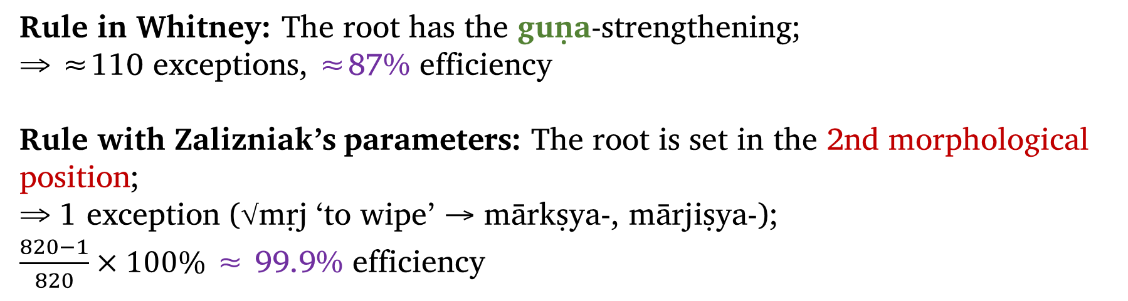
Rule Issue Solution
A |  | B
√ji(I) “to win” | + | -sya- | = | jesya- | guṇa
√car(II) “to move” | + | -sya- | = | cariṣya- | guṇa
√hiṃs(III) “to injure” | + | -sya- | = | hiṃsiṣya- | zero
√dhau(IV) “to run” | + | -sya- | = | dhāviṣya- | vṛddhi
Rule in Whitney: The root has the guṇa-strengthening;
⇒ ≈110 exceptions, ≈87% efficiency
Rule with Zalizniak’s parameters: The root is set in the 2nd morphological position;
⇒ 1 exception (√mṛj ‘to wipe’ → mārkṣya-, mārjiṣya-);
$\frac{820−1}{820}×100\%$ ≈ 99.9% efficiency

Slide 17
Defining of Alternation Parameters
Morphemes of the 1st class: undergo alternation, do not affect alternation:
roots; e.g. vṛ(I,R1): vṛta-, variṣya-, vāriṣ-;
prefixes in secondary nominal derivation; e.g. vi-√raj → vairāgya-;
⇒ define type, series.
Morphemes of the 2nd class: undergo alternation, affect alternation:
most suffixes; e.g. present 5 -(1)nu(I,U1)-: kṛṇvanti, kṛṇoti;
infixes; e.g. present 7 -(1)nø(I,A1)-: yuṅøjanti, yunakti;
⇒ define type, series, morphological position.
Morphemes of the 3rd class: do not undergo alternation, affect alternation:
endings; e.g. 3.sg.P. -(2/3)ti-: kṛnoti, stauti;
absolutive suffixes; e.g. -(1/2)tvā: aktvā (n̥ktvā), aṅktvā;
⇒ define morphological position.

Slide 18
Connective Vowel: Conditions
Connective vowel could appear between morphemes A and B:
if A is not ending in ā or zero grade alternation element;
if B has initial consonant (always except y and variable with v and m) and is not an aorist suffix.
Possible pairs A and B:
case: verbal root +suffix – i appears if the general conditions are met and root is seṭ or some kind of veṭ; same for ī but with few roots as exceptions;
case: verbal root + ending – i/ī appears with the certain roots listed as exceptions by now (e.g. bravīti from {brū}, roditi from {rud});
case: suffix + suffix’ – i appears if the general conditions are met;
case: suffix + ending – ī only with aorist suffixes -s-, -siṣ-, -sa- before 2.sg.P -s and 3.sg.P -t.

Slide 19
Connective Vowel: Seṭ – Veṭ(s) - Aniṭ
“Seṭ”-parameter is actually required only for verbal roots (case 1, and possibly for case 2, since cases 3 and 4 with suffixes show full regularity):
 | Root | future -sya- | desiderative -s- | ppp. -ta- | Others
seṭ | √aṭ(s) | aṭiṣya- | aṭiṭiṣ- | aṭita- | seṭ
aniṭ | √pac(a) | pakṣya- | pipakṣ- | pakta- | aniṭ
veṭ | √tap(v) | tapsya- ⇔ tapiṣya- | titaps- ⇔ ?titapiṣ- | tapta- ⇔ tapita- | veṭ
veṭ1 | √tras(v1) | takṣya ⇔ takṣiṣya- | titakṣ- ⇔ titakṣiṣ- | taṣṭa- | veṭ
veṭ2 | √lap(v2) | lapiṣya- | lilapiṣ- | lapta- ⇔ lapita- | veṭ
veṭ3 | √tras(v3) | trasiṣya- | titrasiṣ- | trasta- | veṭ
veṭ4 | √tyaj(v4) | tyakṣya- ⇔ tyajiṣya- | tityakṣ- | tyakta- | veṭ

Slide 20
Morphophonological Processes: Algorithm
How to transform a chain of morphemes A+B+…+N into actual word AB…N (from AB…N to A+B+…+N backwards)?
Inserting connective vowel i/ī if required by pair of morphemes;
Alternation: placement the alternation element of the morpheme according to its type and morphological position provided by following morpheme;
Root reduplication if required by suffix;
Shift of the alternating element to the same grade of another series if reguired by following morpheme // Sandhi in the verbal root alternating element (see Zalizniak, 1975, Table 1);
General sandhi (see Emenau, 1968)

Slide 21
Morphophonological Generator
здесь будет перфект от √uøc

Slide 22
Spellchecking Scanned Documents
здесь будет про Брахма-упанишаду

Slide 23
Thank you for attention!
«Morphophonological Classification of the Ancient Indian Language Verbal Roots»
A. Zalizniak (english)
Morphological tools
based on this approach
(A. Shirobokov)

